Slide 1
3D Game Engine Programming
Neil Gannon

Slide 2
Geometry
All 3D geometry are created using the same basic shapes
Points
Lines
Triangles
The basic elements of geometry are referred to as primitive objects
A primitive object is
Drawn in 3D space
Use Cartesian coordinates (X, Y, Z)
Vectors for positioning of elements

Slide 3
Primitive Types
MonoGame provides 4 built in primitive object types
TriangleStrip
TriangleList
LineStrip
LineList
Depreciated types
Point list
Anticipated to be depreciated
TriangleList
LineStrip
LineList

Slide 4
Primitive Types
Lines and Triangles can be drawn in two ways
List
Strips
List
Used for drawing separate geometry
Drawing non-related geometry in batches
Typically data is not shared between geometry
Strip
Used with connected geometry
Used to create more complex objects
Expected that data is to be shared
Strips are more performant and efficient than Lists
Saving memory
Faster drawing

Slide 5
Lines
Lines are really just two vertices
Start vertex
End vertex
The farther apart the vertices, the longer the line.
Can be used for debugging purposes
Visualize elements such as ray tracing etc.

Slide 6
Line Strip
A line strip can be thought of as an array of joining lines
Sequence of lines where the end vertex of one line becomes the starting vertex for the next line.
These lines are connected and share some common vertices

Slide 7
Triangles
The triangle is a basic and very important primitive.
Three vertices
One vertex for each corner of the triangle.
Using a combination of triangles it’s possible to create more complex shapes.
3D models a simply a collection of triangles

Slide 8
Triangle List
Triangle strips are sequences of unconnected triangles.
Similar concept to Line Lists

Slide 9
Triangle Strip
Like line strips, triangle strips are sequences of connected triangles.
The triangles are joined at the edges.
In a strip each triangle reuses the previous two vertices of the last triangle
From this you can form all kinds of complex shapes, like squares, spheres and cones.

Slide 10
Vertices

Slide 11
Vertex
Even the most complex 3D objects are constructed using primitives
A 3D model is simply a file containing vertex information
A vertex stores information such as
X, Y, Z Position (this is the minimum requirement for a vertex type)
Colour
Texture coordinates
Normal Vector (direction which the vertex is facing)
These vertices can be rendered by outputting points for each vertex and shading the surface they create
Wireframe (Lines between points)
Solid (Series of linked triangles)

Slide 12

Vertex Types
A vertex can store multiple types of data
Position
Colour
Texture Coordinates
Normal Vector
Custom data for use on the GPU
MonoGame provides 4 built in types
VertexPositionColor (Vector3, Color)
VertexPositionTexture (Vector3, Vector2)
VertexPositionColorTexture (Vector3, Color, Vector2)
VertexPositionNormalTexture (Vector3, Vector2, Vector3)

Slide 13
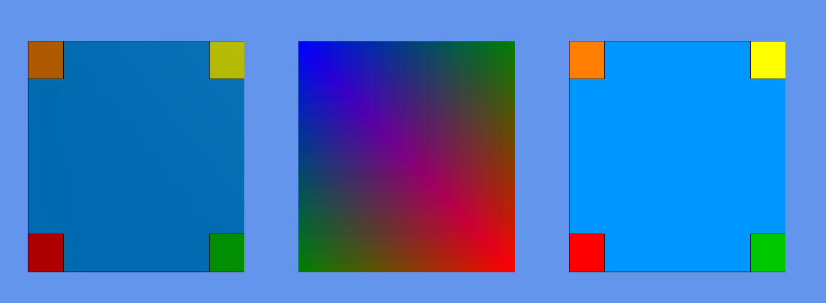
Vertex Types
VertexPositionNormalTexture
VertexPositionColor
VertexPositionTexture

Slide 14
Vertex Declaration
A vertex declaration stores the vertex format to be used when drawing objects
Specifies the properties of the vertex
And the data type of property (Color, Vecto2, Vector3, float etc.)
When drawing an object we must provide the graphics device with the correct format
Inform the effect what data it can expect
Allows for the proper retrieval of data on the GPU
Vertex stride (size in bytes of each vertex)
Before drawing the graphics device vertex declaration property must be set
Already done in MonoGame
We can define our own vertex format for custom effects
Using IVertexType
Declare the VertexDeclaration
Used with custom shaders

Slide 15
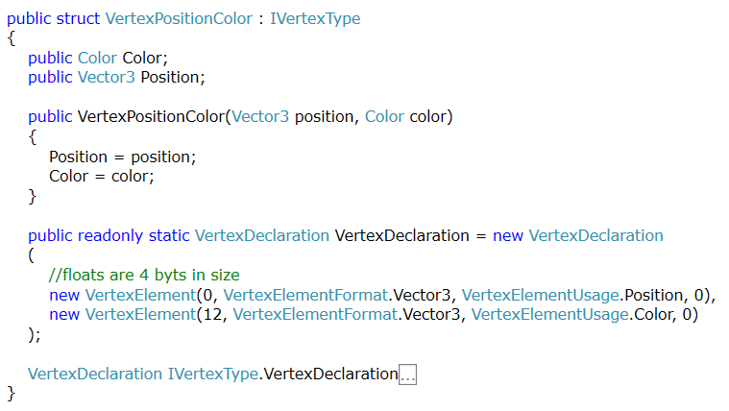
Vertex Declaration Sample

Slide 16
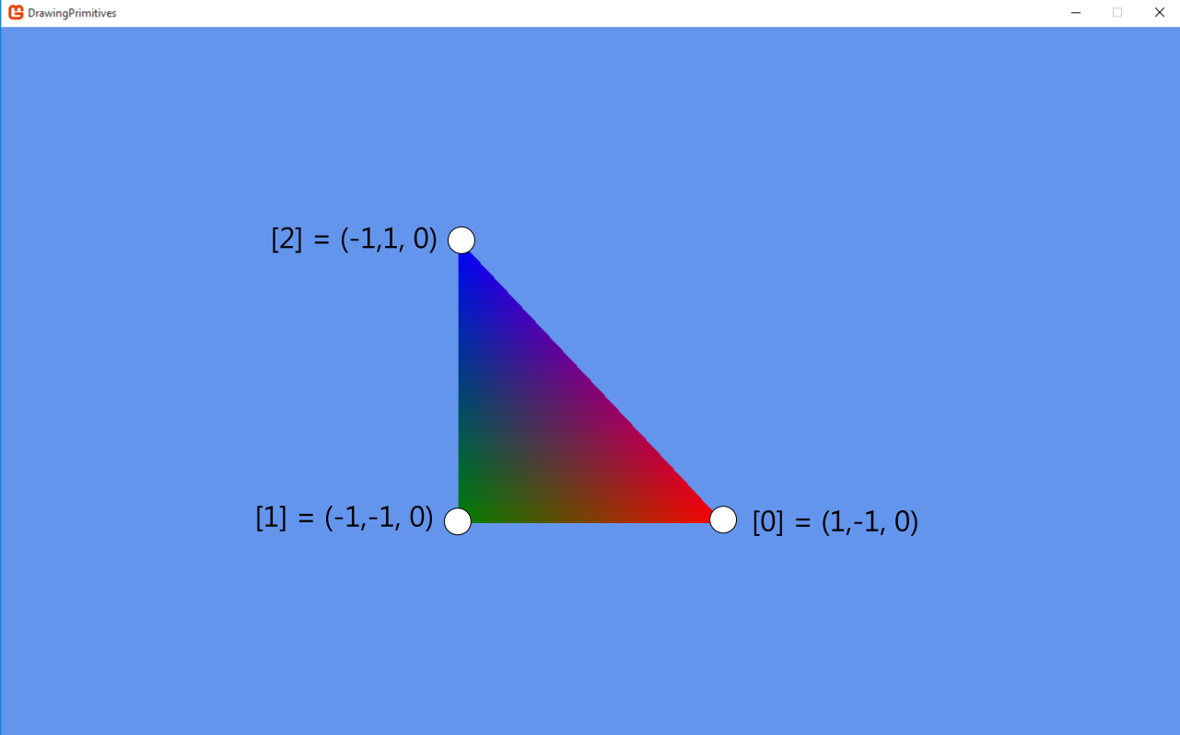
Adding Vertices
When creating vertices we declare their positions in local space
These positions will later be translated to world space using a matrix
Winding Order
Vertices should be added to the buffer in a clockwise order
The GPU will cull triangles declared in the anti-clockwise way
This can be changed

Slide 17
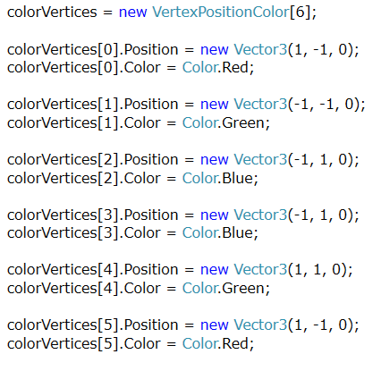
Adding Vertices
Declare an array of a vertex type somewhere in the scope that in can be drawn later
Instantiate the array with number of vertices you require
Declare each vertex in the array manually
Set the required vertex properties
Here it is just Position and Color
Ensure all vertices have setup correctly

Slide 18
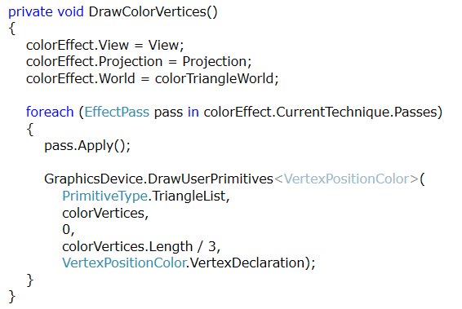
Drawing Vertices
Using the built in BasicEffect set the following properties
World
View
Projection
Apply the current pass
Send the vertices to actual graphics hardware
Primitive Type
Vertex Data
Start
Number of Primitives
Vertex Declaration

Slide 19
Drawing Primitives
Choose/Declare the vertex type to be used
Create an array (buffer) of vertex data
If not using a model
Define each vertex and all its properties (Position, Color etc.)
Create an effect to draw the vertices with
BasicEffect
Set world , view and projection matrices on the effect
Set the primitive type
Lines or Strips
Set the starting element in the vertex array
Set the number of primitives to be drawn from the vertex array
Vertices / 3

Slide 20
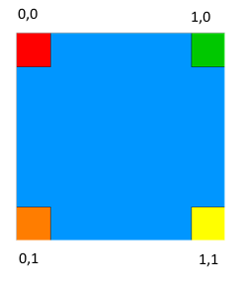
Texture Coordinates
UV coordinates exist in Texture Space
This space has Min and Max limits between (0,0) and (1,1)
The actual size of the texture doesn’t matter
When applying a texture coordinate to a vertex you only need to know where in this texture space your vertex should be

Slide 21
Optimizations

Slide 22
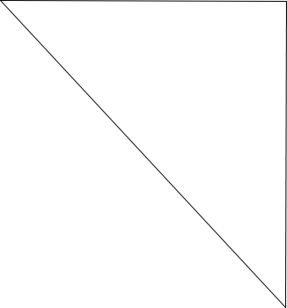
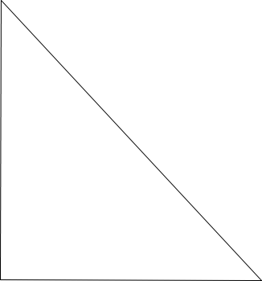
Optimizations
3 Vertices
3 Vertices

Slide 23
Optimizations
Declaring just the vertices results in duplication of data
Two vertices are in the same position for each triangle but we do not share this data in any way
Indexing will us to remove duplicates and simply point a vertex to reuse an existing one
3 Vertices
3 Vertices

Slide 24
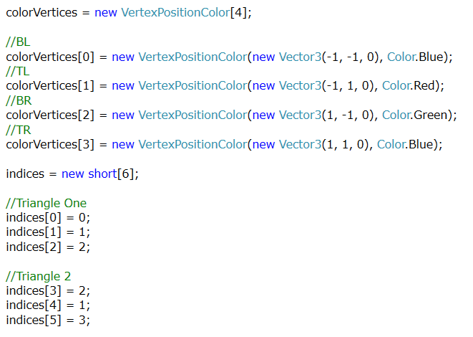
Indexing
Declare an array of a vertex type and an array of an index type (int, short) somewhere in the scope that in can be drawn later
Instantiate the indices array with number of vertices you require (include duplicates)
Instantiate the vertex array with the number of vertices (subtract duplicates)
Declare each vertex in the array manually
Note do not declare any duplicates here
Declare all the indices
If a vertex shares data with another then the index should point to that vertex
Position in the Vertex Array

Slide 25
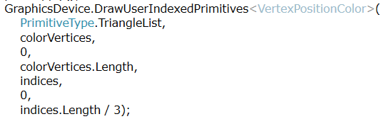
Drawing Indexed Primitives
Near identical to non-indexed drawing
Inclusion of indices is required
Primitive count is now determined by the number of indices
Vertices array have been optimized
Indices array now contains the true number of vertices
Number of primitives is now the number of indices / 3

Slide 26
Buffers

Slide 27
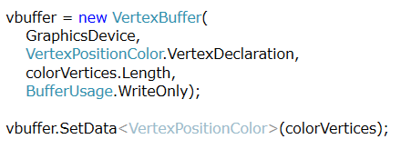
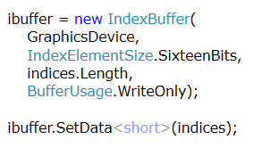
Vertex Buffer
Currently sending vertex data every frame
This data isn’t changing after declaration
Buffers allow for data to be stored in video memory
Send once
Future draw calls use data from GPU memory
Vertex and Index Buffers exist for this purpose

Slide 28
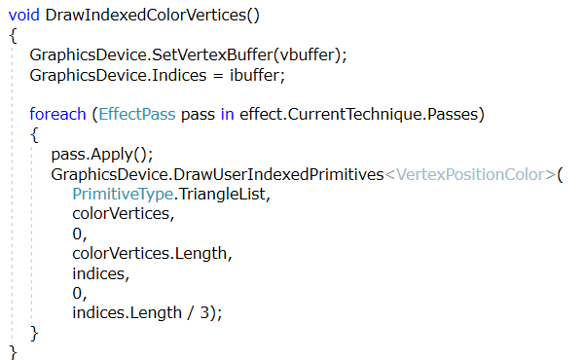
Drawing
The GPU needs for both buffers to be set before drawing
GPU Driver handles the retrieval and drawing of buffers stored in video memory

Slide 29
Summary
All 3D geometry are composed of simpler shapes
Lines
Triangles
These shapes are again composed of vertices
These vertices can hold a lot of data
At a minimum it must have at least a Position
We can create our own but MonoGame provides 4 common ones
We send an array of these vertices to graphics device
Tell it what type of vertex data is coming
Tell it how many and what primitive type we want to draw
Send to the GPU and apply the effect

